Slide 1
IBM University Engagement Project Submission
“Exploring the Power of Agentic AI with IBM Granite and IBM Bob”

Slide 2

Project Tile – The Athlete Performance Analysis Assistant The Challenge
Domain of Project – Sports Technology
Student Name | Recent Passport Photo | Email ID | Mobile number [WhatsApp]
DARSHINI H L |  | darshinigowda244@gmail.com | 9110825080

Slide 3
Problem Statement -
Problem Statement : The Athlete Performance Analysis Assistant
The Challenge
Athletes generate large amounts of performance data during training and competitions, including fitness metrics, match statistics, and workload indicators. Coaches often struggle to convert this raw data into actionable insights that improve performance.
The Objective
Build an AI‑powered Athlete Performance Analysis Assistant that evaluates athlete performance using training data, fitness metrics, and match statistics.
1. Performance Data Retrieval (RAG) :– Collect athlete statistics, training records, and fitness data.
2. Performance Trend Analysis :– Identify strengths, weaknesses, and improvement opportunities.
3. Training Recommendations :- Suggest personalized training strategies based on performance patterns.
4. Coaching Insights :– Provide clear summaries and reports for coaching staff.
5. Multi‑Agent System
Athlete Data Agent – Retrieves training and performance data.
Performance Analysis Agent – Evaluates performance metrics and trends.
Training Recommendation Agent – Suggests improvement strategies.
Coaching Insight Agent – Generates performance reports.
6. Visualization Dashboard
Display performance trends, fitness metrics, improvement suggestions, and athlete comparisons.

Slide 4
Proposed Solution -
Proposed Solution – AI-Powered Player Recruitment Intelligence Agent
The proposed solution is a multi-agent AI-powered Player Recruitment Intelligence Agent built using IBM Bob, IBM watsonx.ai, and Granite Models to help sports teams identify suitable players through data-driven analysis.
The system uses a Retrieval-Augmented Generation (RAG) pipeline to retrieve player statistics, match records, and scouting reports. It consists of four key agents:
1. Player Data Agent: Retrieves player statistics and match records.
2. Performance Analysis Agent: Evaluates players' strengths, weaknesses, scoring ability, and consistency.
3. Recruitment Recommendation Agent: Matches players with team requirements and ranks suitable candidates.
4. Scouting Insight Agent: Generates scouting reports and recruitment insights.
An interactive dashboard displays player rankings, performance comparisons, team-fit scores, and recruitment recommendations. IBM Bob supports application development, while watsonx.ai and Granite models can power AI-based analysis and recommendations.
Overall, the solution helps sports teams make faster, smarter, and data-driven recruitment decisions.

Slide 5
Technology Used
IBM Bob – For application development and multi-agent workflow coordination.
IBM Granite Models – For player performance analysis and AI-powered recommendations.
IBM Cloud – For application deployment and hosting.
RAG – For retrieving player statistics and scouting reports.
IBM watsonx.ai – For AI model integration and embeddings.
FAISS/Chroma – For vector-based player data retrieval.
Python and Web Technologies – For data processing, backend development, and the interactive dashboard.

Slide 6
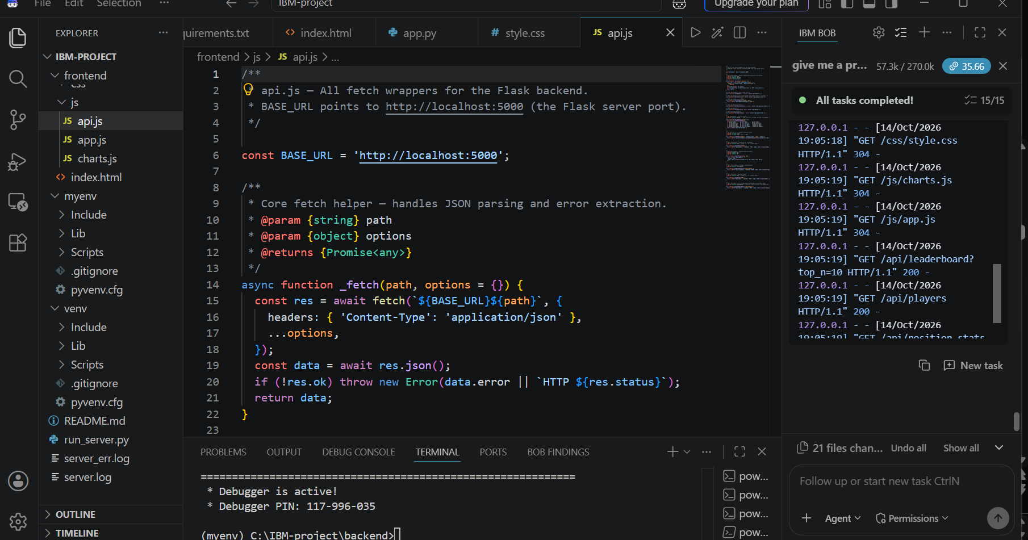
Required Files created using IBM bob -
1. App.py
2. Requirements.txt
3. Index.html
4. Style.css
5. Api.js
6. README.md

Slide 7
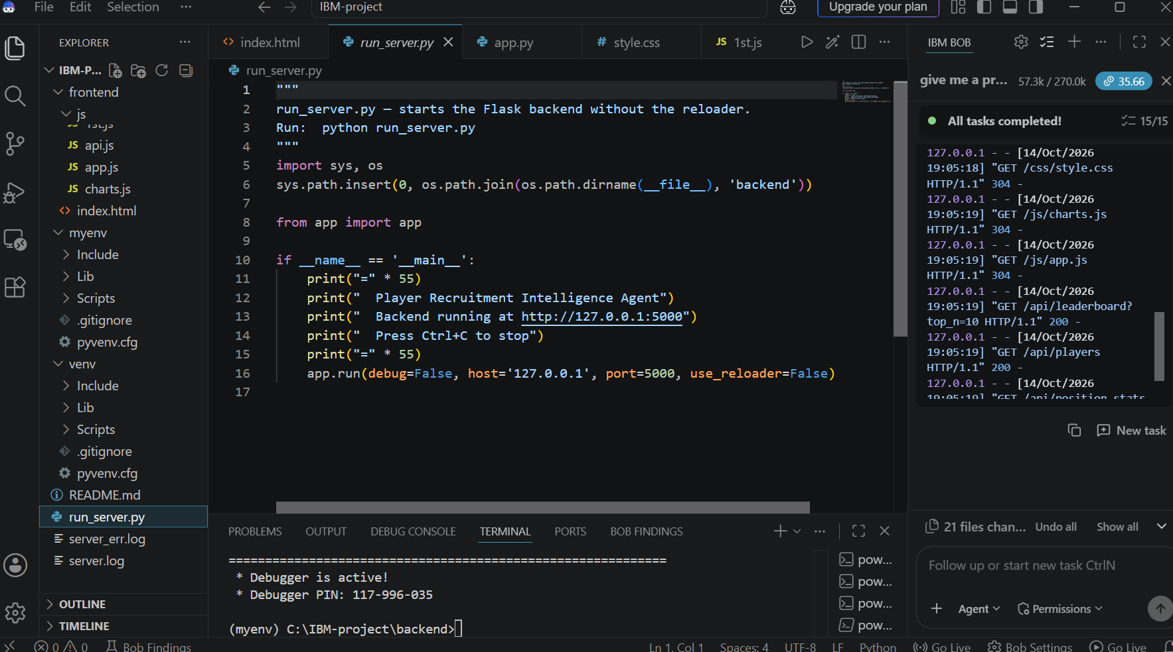
IBM Bob Screenshots:

Slide 9
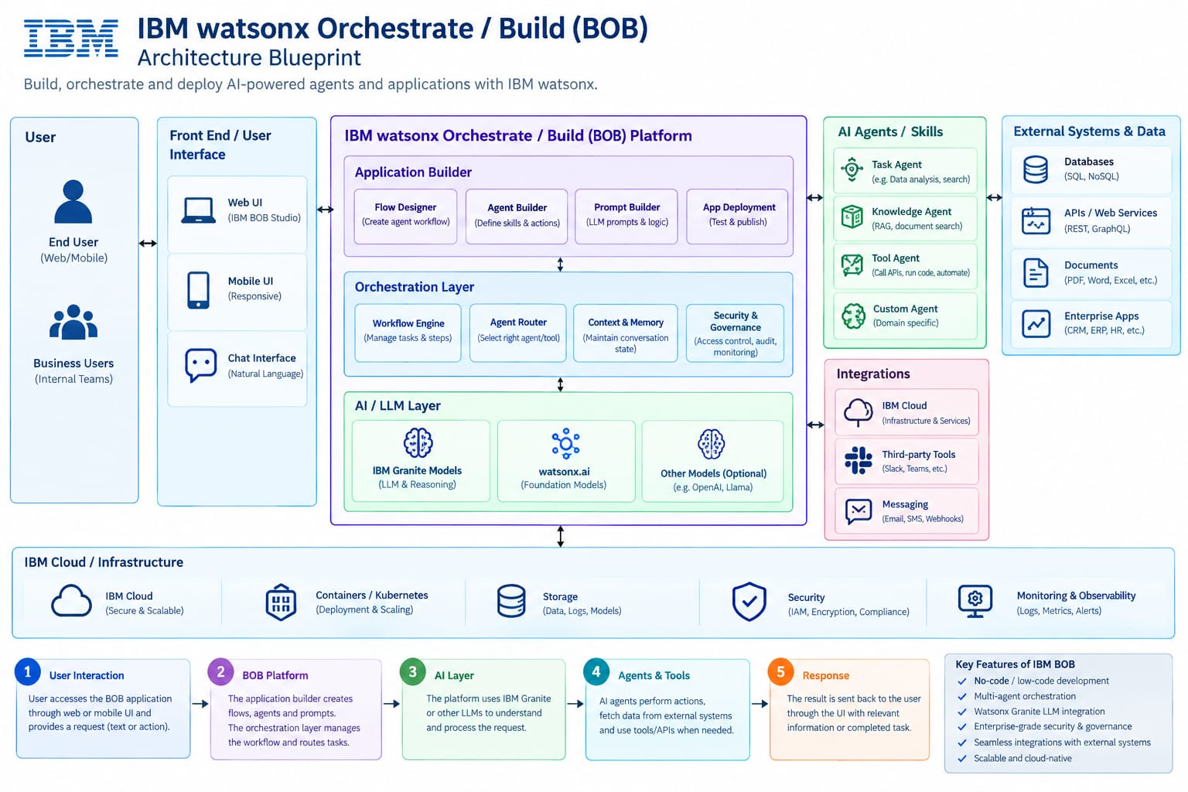
Architecture blueprint for IBM bob:

Slide 10

Role of Agentic AI in the solution
Role of Agentic AI in Nutrition Agent
Agentic AI enables the Nutrition Agent to function as an intelligent, autonomous system rather than a simple chatbot. Using IBM watsonx.ai and IBM Granite models, it coordinates multiple specialized agents to deliver personalized nutrition guidance.
Each agent performs a specific role—such as retrieving nutritional data, generating diet plans, providing health advice, and analyzing food logs—while working collaboratively. This multi-agent approach ensures efficient task execution and accurate results.
Agentic AI also brings context awareness, understanding user details like age, health conditions, and fitness goals to generate tailored recommendations. It supports real-time adaptation, continuously updating suggestions based on user inputs like daily meals.
Additionally, agents communicate with each other, enabling better decision-making and improved outcomes.
Overall, Agentic AI makes the system proactive, personalized, and goal-driven, acting like a smart digital nutritionist that helps users maintain a healthy lifestyle.

Slide 11
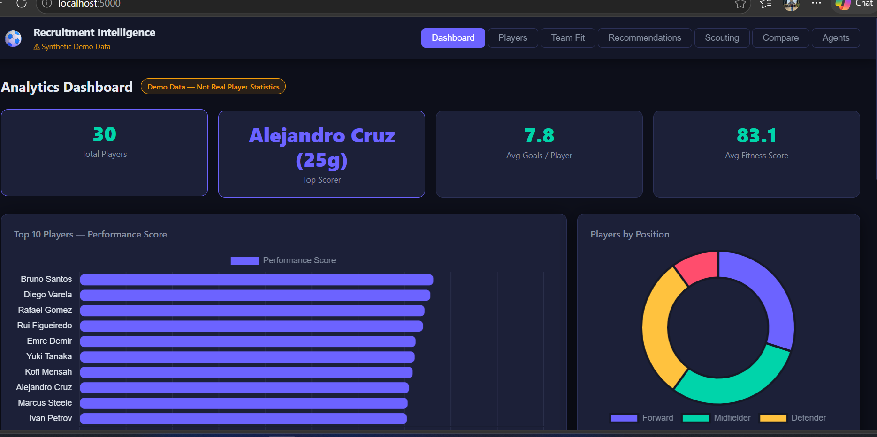
Project Output Screenshot
Please put IBM Bob output screenshots with 2-3 prompts.
You can take 2-3 more slides for each screenshot
·
·
·

Slide 12
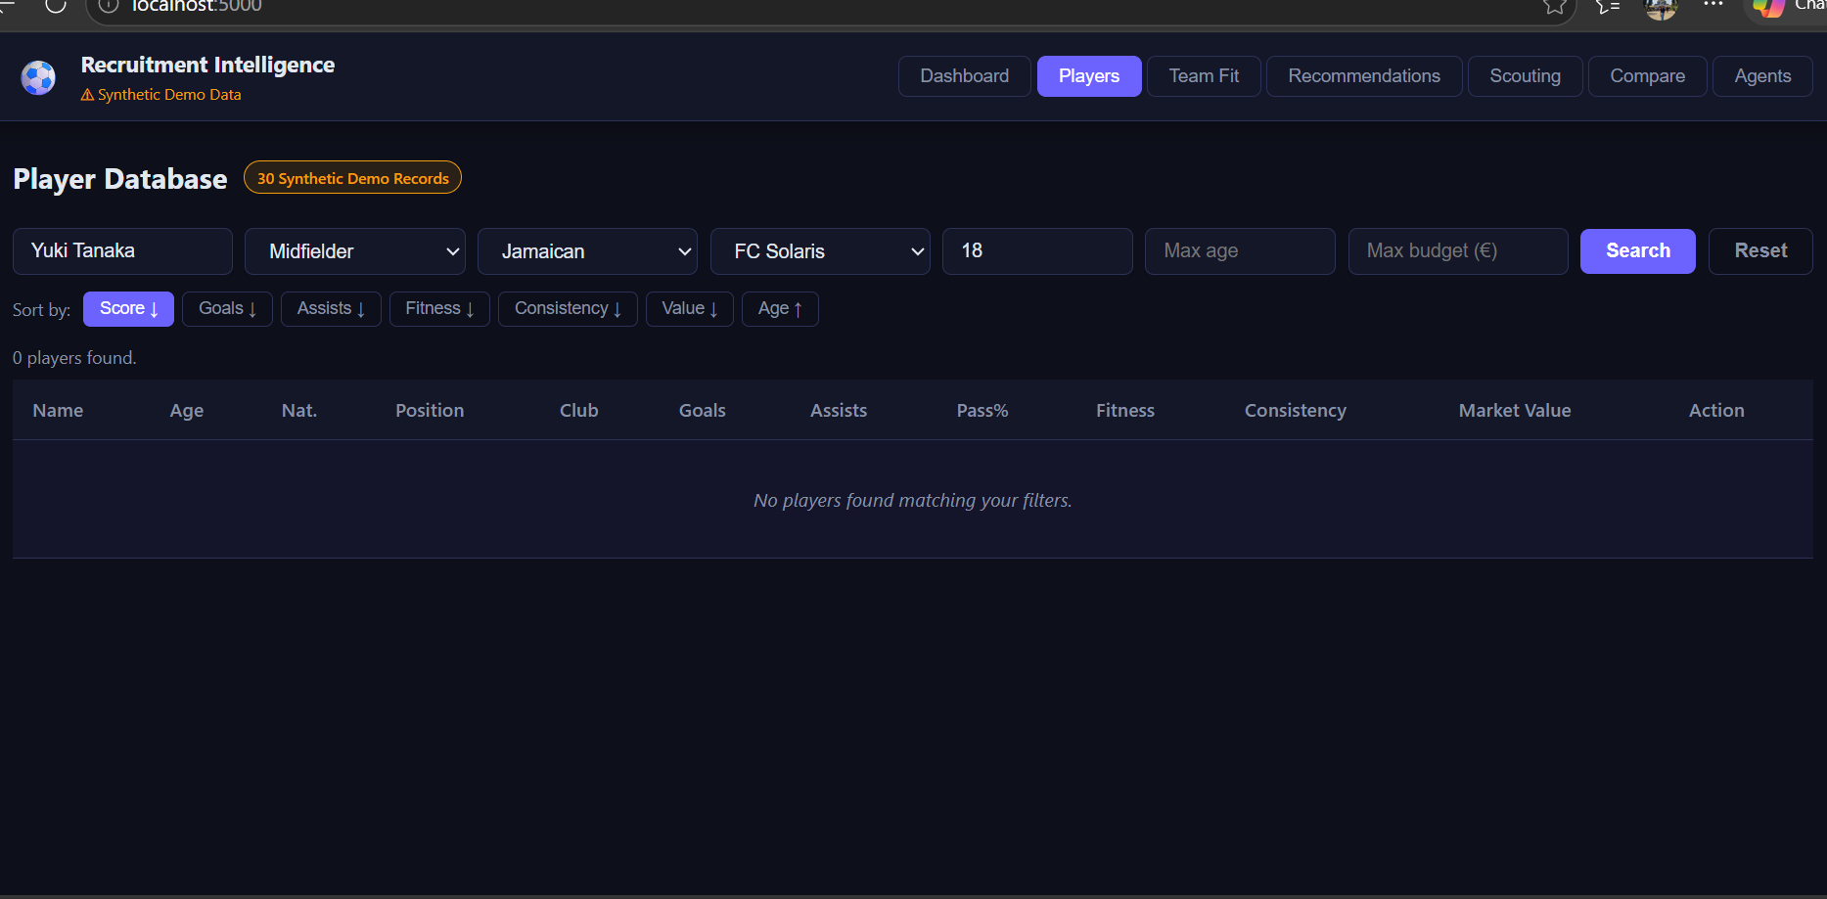
Project Output Screenshot
Please put IBM Bob output screenshots with 2-3 prompts.
You can take 2-3 more slides for each screenshot
·
·
·

Slide 13
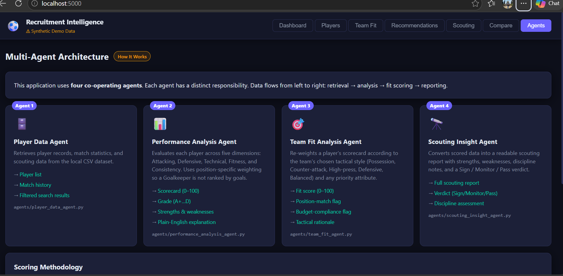
Project Output Screenshot
Please put IBM Bob output screenshots with 2-3 prompts.
You can take 2-3 more slides for each screenshot
·
·
·

Slide 14
Novelty and Uniqueness
Key Features and Unique Value Proposition
Multi-Agent Intelligence – Multiple AI agents collaborate to analyze player statistics, match performance, and scouting reports.
RAG-Based Accuracy – Retrieves relevant player data to generate reliable, data-driven recommendations.
Personalized Recommendations – Suggests suitable players based on position, performance, team needs, and budget.
Real-Time Analysis – Updates player evaluations when new performance data becomes available.
Multi-Source Data Integration – Combines match statistics, historical records, and scouting reports.
Talent Discovery – Identifies promising players and compares their strengths and weaknesses.
Scalability – Uses IBM watsonx.ai and IBM Granite models to support intelligent recruitment workflows.
Overall, the solution acts as a smart AI scouting assistant that helps sports teams identify talent and make better recruitment decisions.

Slide 15
Git Hub Link
· Please create public github repository (Enable Add README button while creating repository) with format –
Please test and Paste the working Github URL –
Make sure you have Uploaded following three files into your github repository
1) All Agent relevant files of IBM Cloud , 2) yourproblemstatement.pdf file 3) your projectpresntation.pptx file 4)any other files
·
·
·

Slide 16
Future Scope
Integration with Live Sports Data & Performance Tracking –
The system can be integrated with live sports APIs and performance-tracking platforms to collect updated player statistics, match records, and fitness metrics. This will enable more accurate player evaluations and timely recruitment recommendations.
2. AI-Powered Scouting Assistant & Multilingual Support –
Enhancing the system with a voice-enabled assistant and multiple language support will help coaches and scouts interact easily, compare players, and receive recruitment insights in their preferred language.
·
·
·

Slide 17
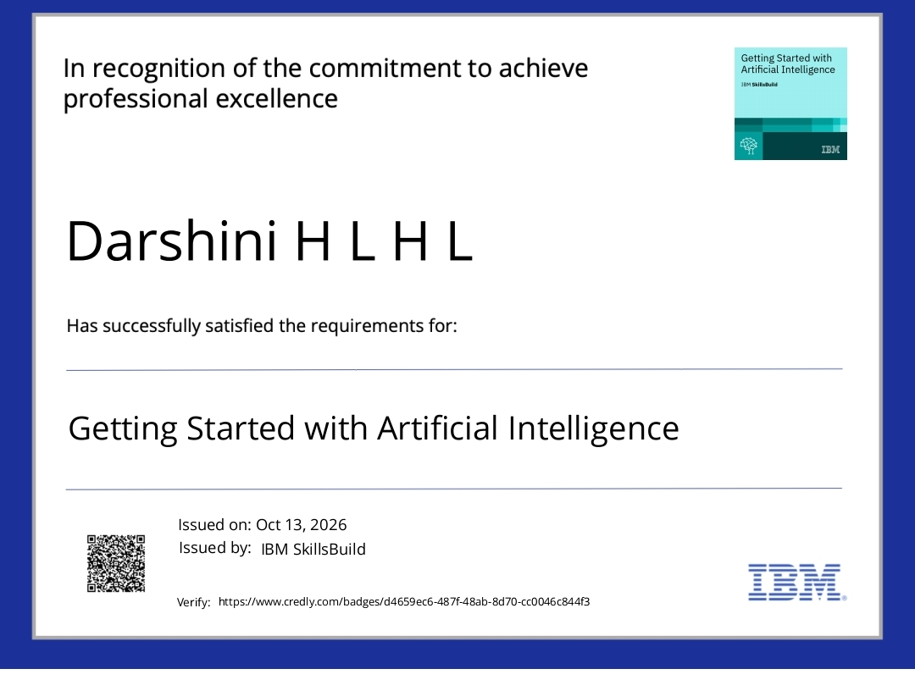
Certificates Earned:

Slide 18
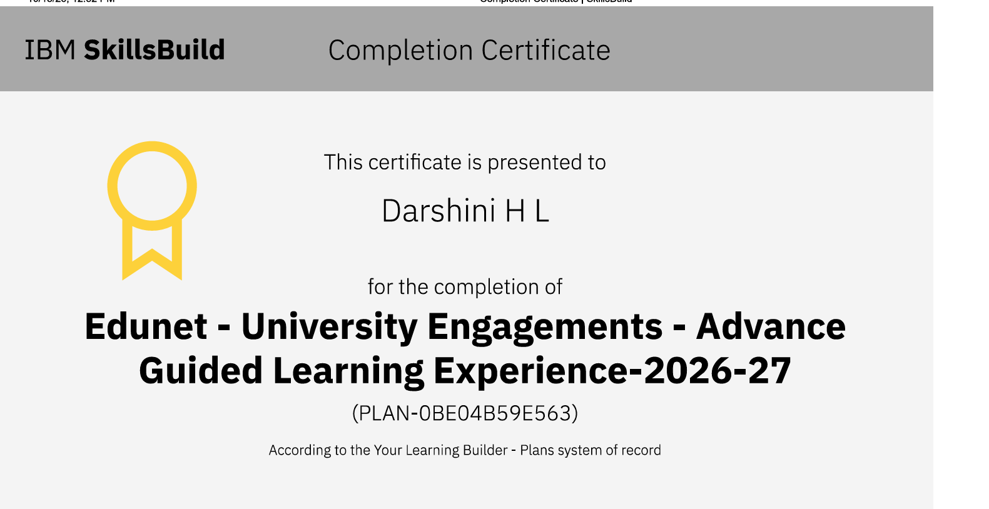
Certificates Earned:​

Slide 19


